Slide 1


The R2E2 Playbook
R2E2playbook.org
June 26, 2024

Slide 2



























:
Residential Retrofits for Energy Equity (R2E2) is a nationwide initiative that provides technical assistance to state and local governments as well as community-based organizations and other partners to jumpstart energy upgrades for affordable housing that:
  lower utility bills
  reduce greenhouse gas emissions
  improve residents’ health
  create good-paying local jobs, and
  help advance racial equity.
Partners:

Slide 3
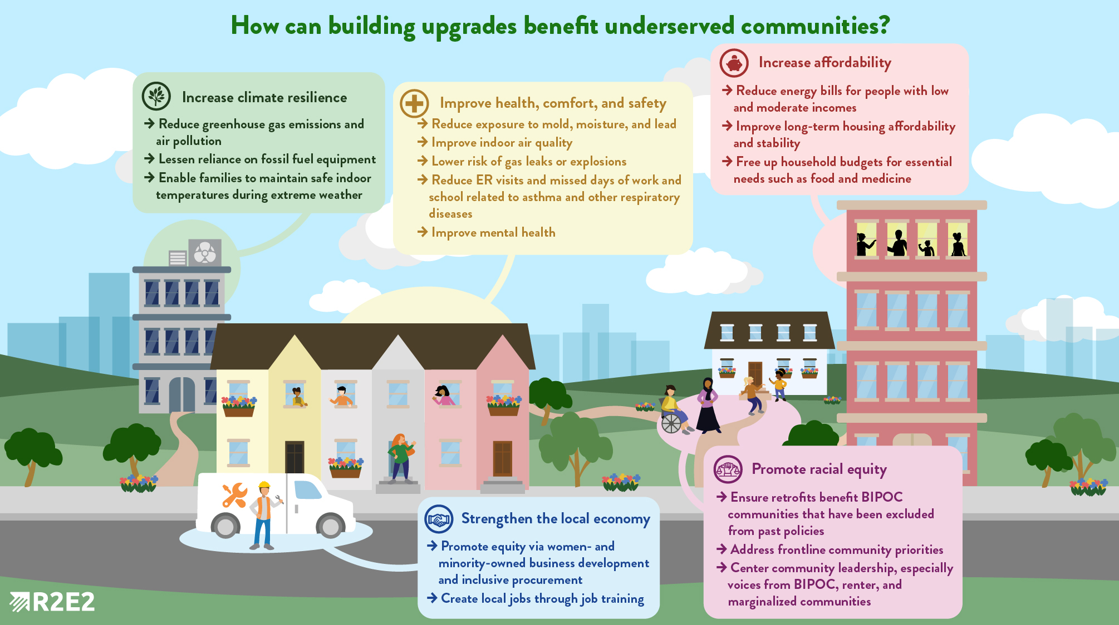

Slide 4





Speakers
Annika Brindel
Director
Residential Retrofits for Energy Equity, ACEEE
Claire Oleksiak
Executive Director
Sustain Dane
Ian Becker
Manager
Residential Retrofits for Energy Equity, ACEEE
Simon Mugo
Program Manager
NYC Accelerator
Marty Josten
Principal Director
Building Decarbonization, New Ecology

Slide 5
On Today's Webinar
Overview of the R2E2 Playbook – Ian Becker
Case Study #1: Efficiency Navigator – Claire Oleksiak
Case Study #2: NYC Accelerator – Simon Mugo
Case Study #3: New Ecology – Marty Josten
Q&A

Slide 6
Housekeeping
We are recording this webinar and will be making it available to all registrants within a few business days.
To ask a question during the webinar, please submit it via the Q&A button at the bottom of your screen.
You can upvote questions in the Q&A box that you would like us to prioritize.
Use the chat to engage in respectful and productive discussion with other participants.
Code of conduct: R2E2 will not tolerate behaviors that cause harm or disrupt the learning environment. Please direct message Stephanie Sosa-Kalter if you feel unsafe in this space. Disruptive participants may be removed from the webinar.
Notes:
But first, some brief housekeeping notes.
We are recording this webinar and will be making it available to all registrants within a few business days. ​
To ask a question during the webinar, please submit it via the Q&A button at the bottom of your screen.
You can upvote questions in the Q&A box that you would like us to prioritize. ​
Use the chat to engage in respectful and productive discussion with other participants. ​
We have a few additional requests for you today in order to foster a productive environment. Please be mindful of sharing space and remember that we all have something to learn from one another.
We also ask you to adhere to our code of conduct: R2E2 will not tolerate behaviors that cause harm or disrupt the learning environment. Please direct message Stephanie Sosa-Kalter if you feel unsafe in this space. Disruptive participants may be removed from the webinar. Thank you for helping to create a positive learning environment for everyone here today.

Slide 7
The R2E2 Playbook
Ian Becker
Manager
Residential Retrofits for Energy Equity, ACEEE

Slide 8
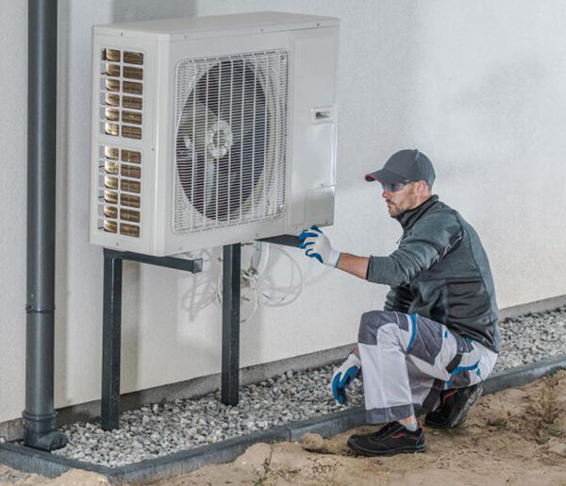
The Problem
Too many low- and moderate-income households have not reaped the benefits of past energy efficiency efforts, contributing to high energy bills, housing unaffordability, and poor home conditions.
67% percent of households with low incomes face a high energy burden.
27.5% of all U.S. households have low incomes, but only 13% of overall spending from utility efficiency programs go to these households.
Energy burdens are disproportionate: Black, Hispanic, Native American, older adult households, and families residing in low-income multifamily housing experience higher energy burdens.

Slide 9
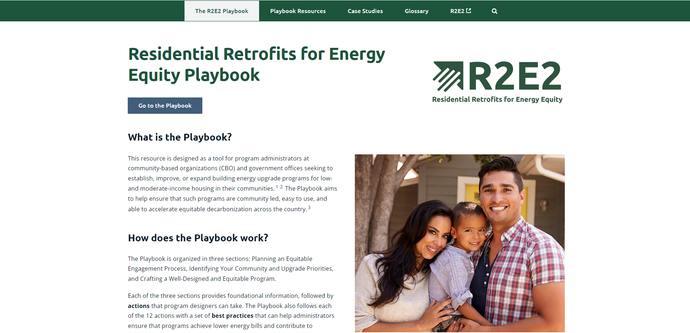
https://r2e2playbook.org/
Notes:
Include text describing playbook. "Program administrators can use the step-by-step guidance to create and expand programs. Stakeholders can draw inspiration from the myriad case studies."

Slide 10













What actions does the Playbook recommend?
1. Begin with a landscape analysis. | 7. Design program in coordination with partners.
2. Design equitable engagement activities. | 8. Prioritize the most energy insecure LMI households to receive upgrades.
3. Identify program focus areas. | 9. Build accountability into the program.
4. Establish program upgrade offerings. | 10. Ensure the program provides health and safety measures.
5. Design program offerings to prevent increased household costs and displacement. | 11. Ensure the program streamlines how users access funding.
6. Create an easy-to-use program intake, participation, and support process. | 12. Ensure the program helps build out a local green workforce.

Slide 11
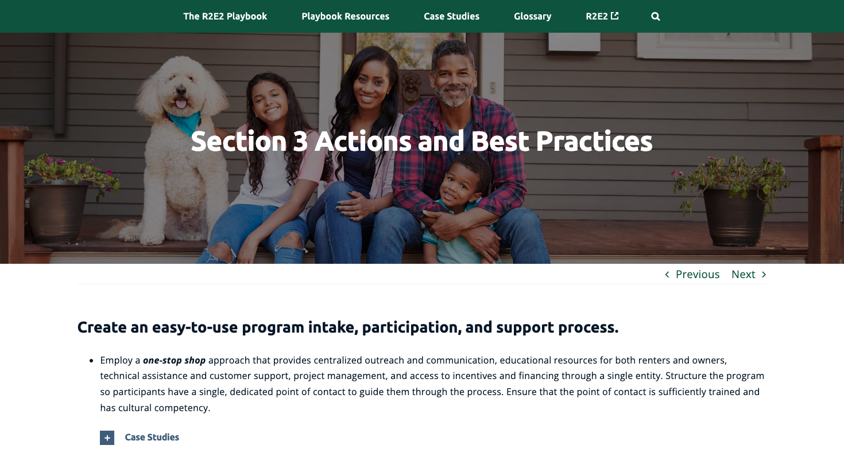

Slide 12
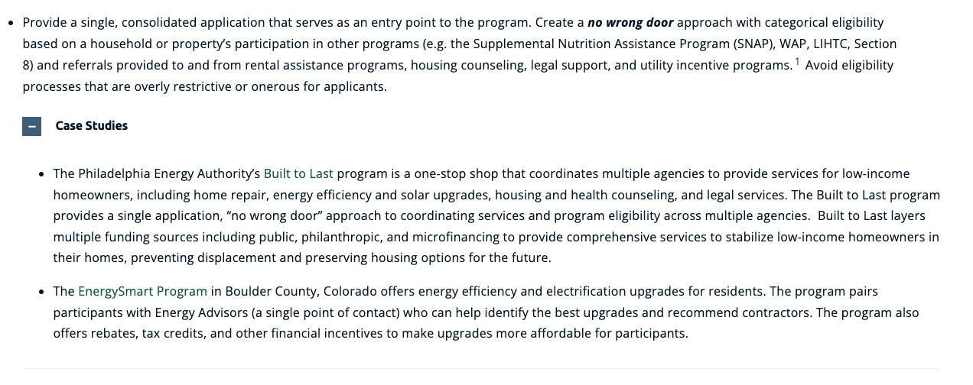
Case Study Examples

Slide 13
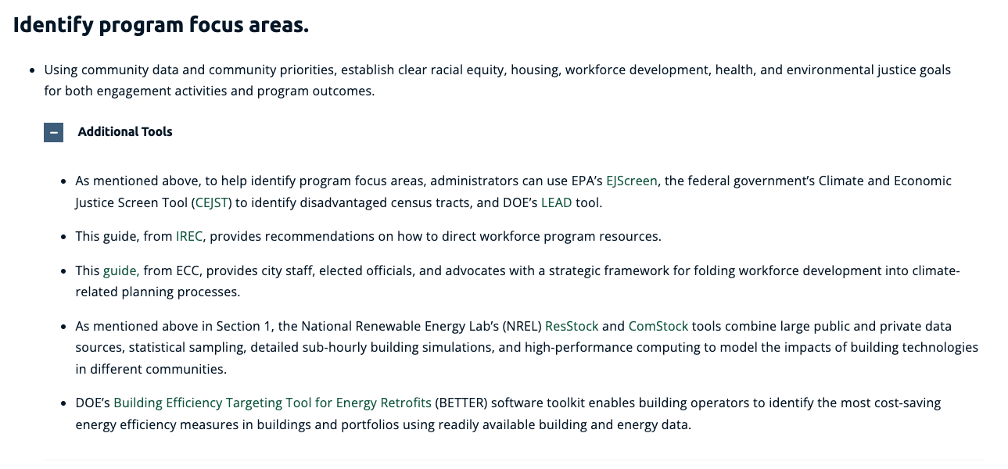
Additional Tool and Resource Examples

Slide 14




Playbook Stats
40+ Best Practices
90+ Case Studies
120+ Additional Tools and Resources

Slide 15
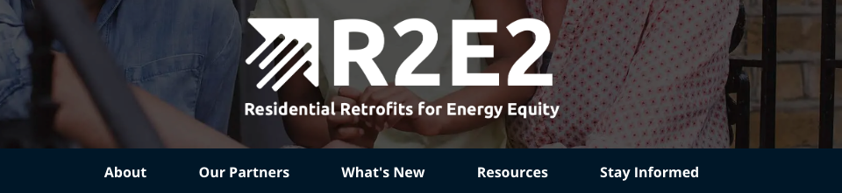

Contact us!
Reach out to us with questions or suggestions via the "Stay Informed" tab on the R2E2 website.

Slide 16
Case Study #1: Sustain Dane
Playbook Location:
Section 2: Identifying Your Community and Upgrade Priorities
Action 5: Design program offerings to prevent increased household costs and displacement.
Claire Oleksiak
Executive Director
Sustain Dane

Slide 17


Slide 18
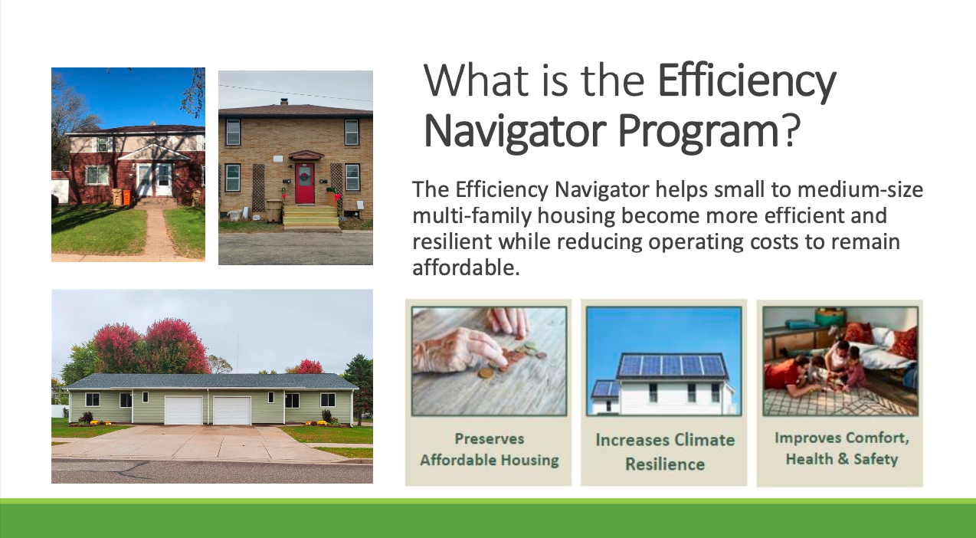

Slide 19
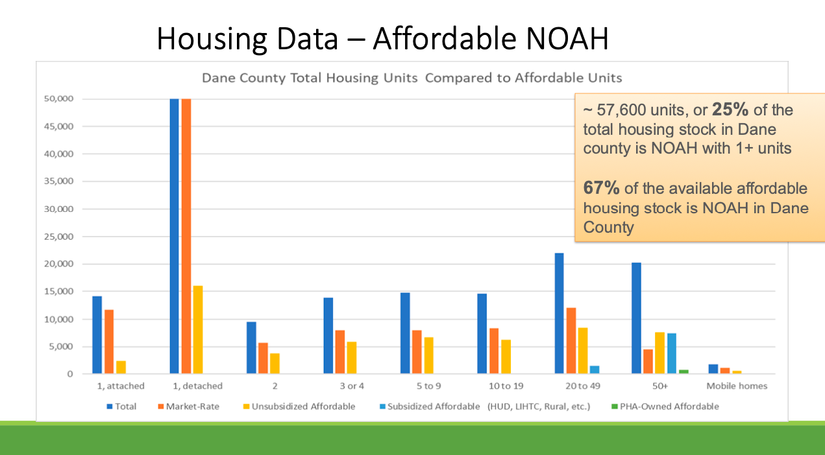

Slide 20
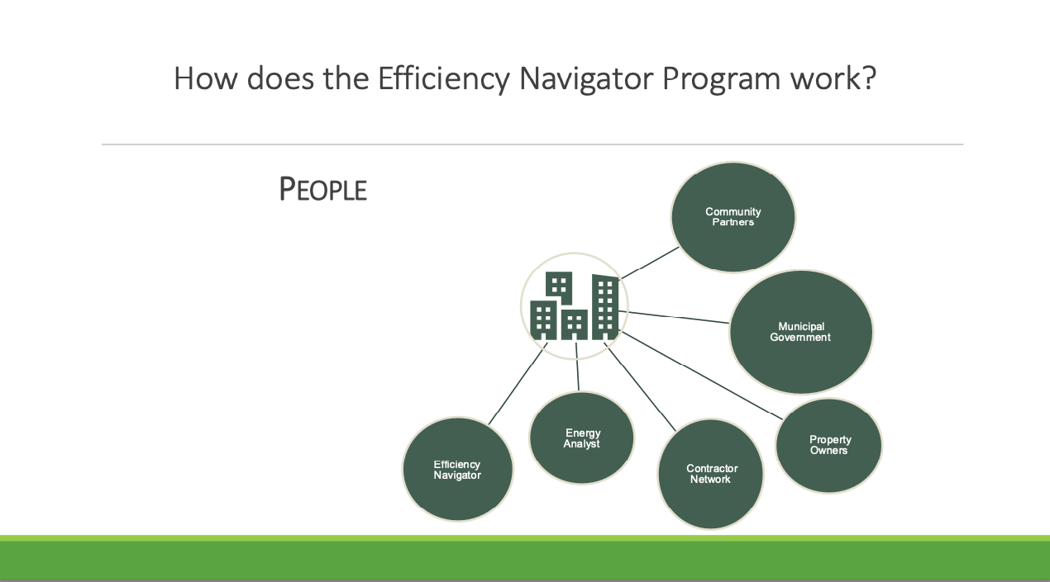

Slide 21
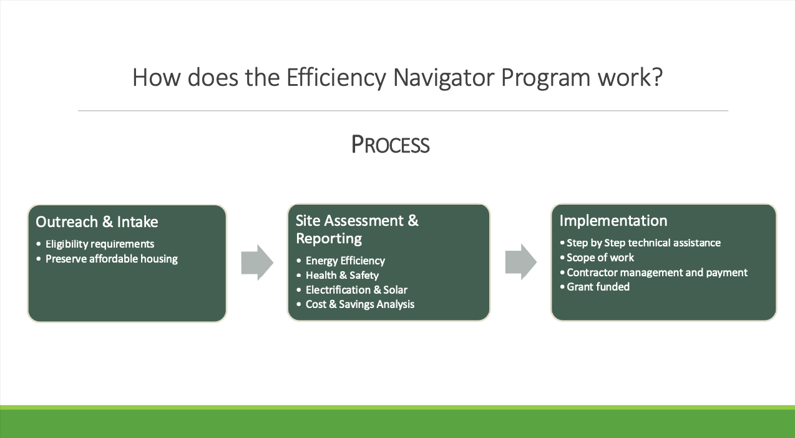

Slide 22
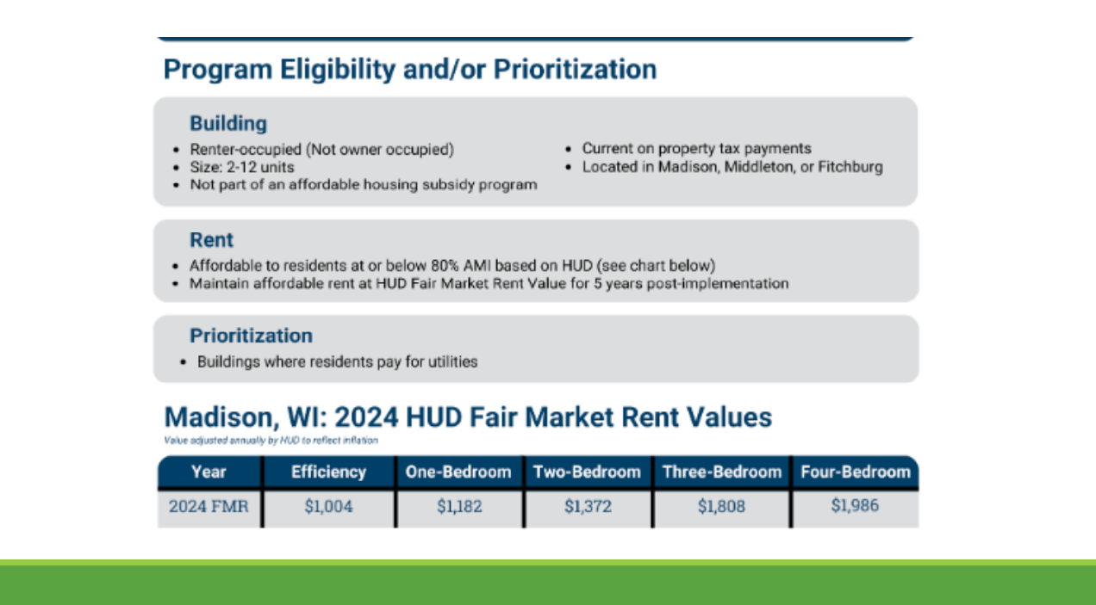

Slide 23
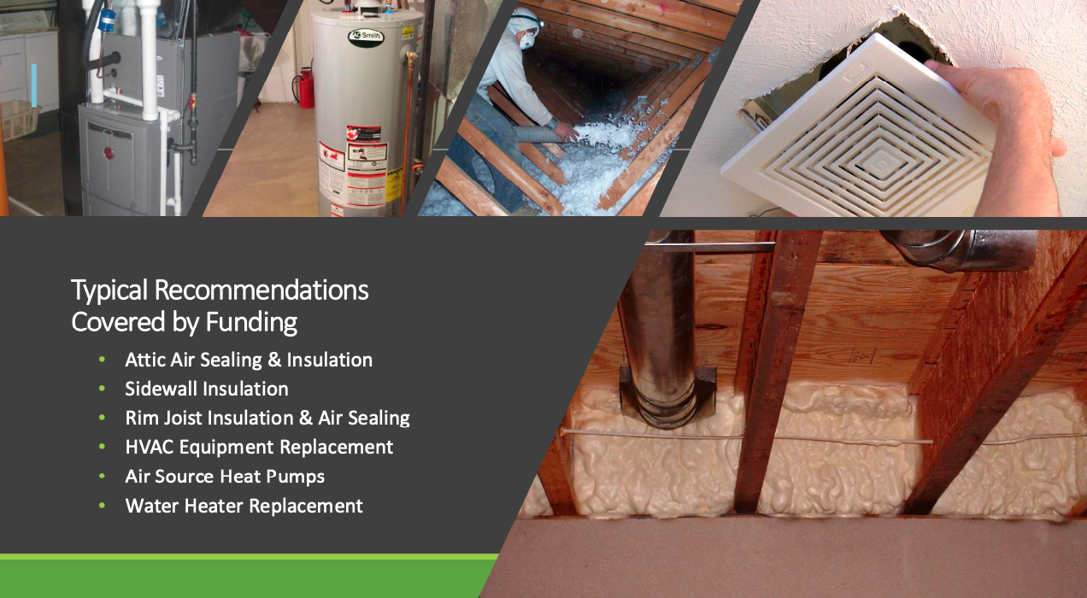

Slide 24
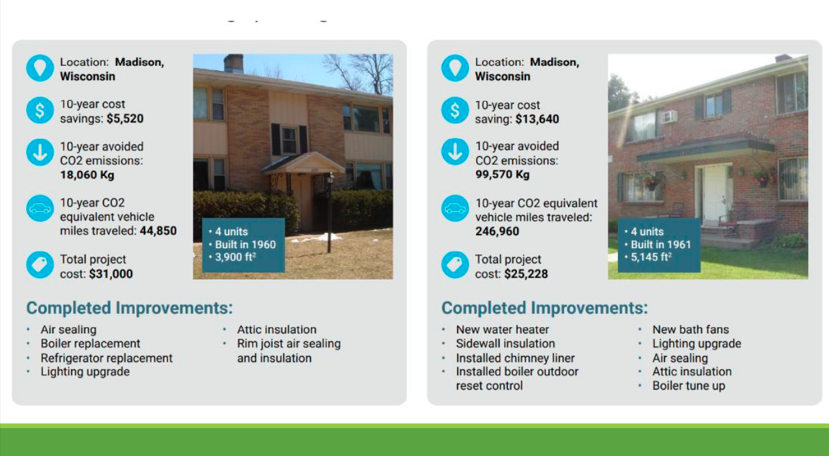

Slide 25
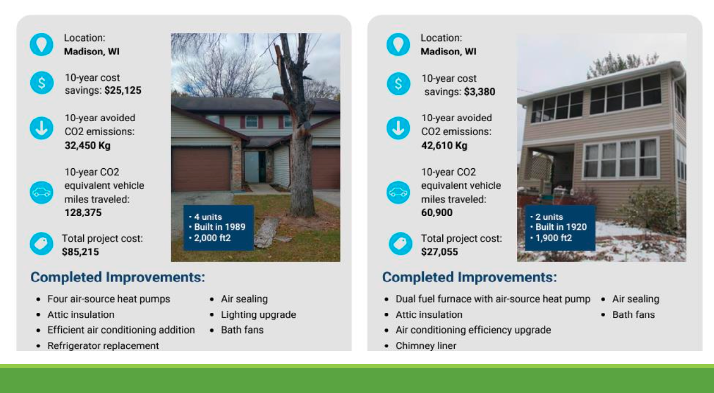

Slide 26
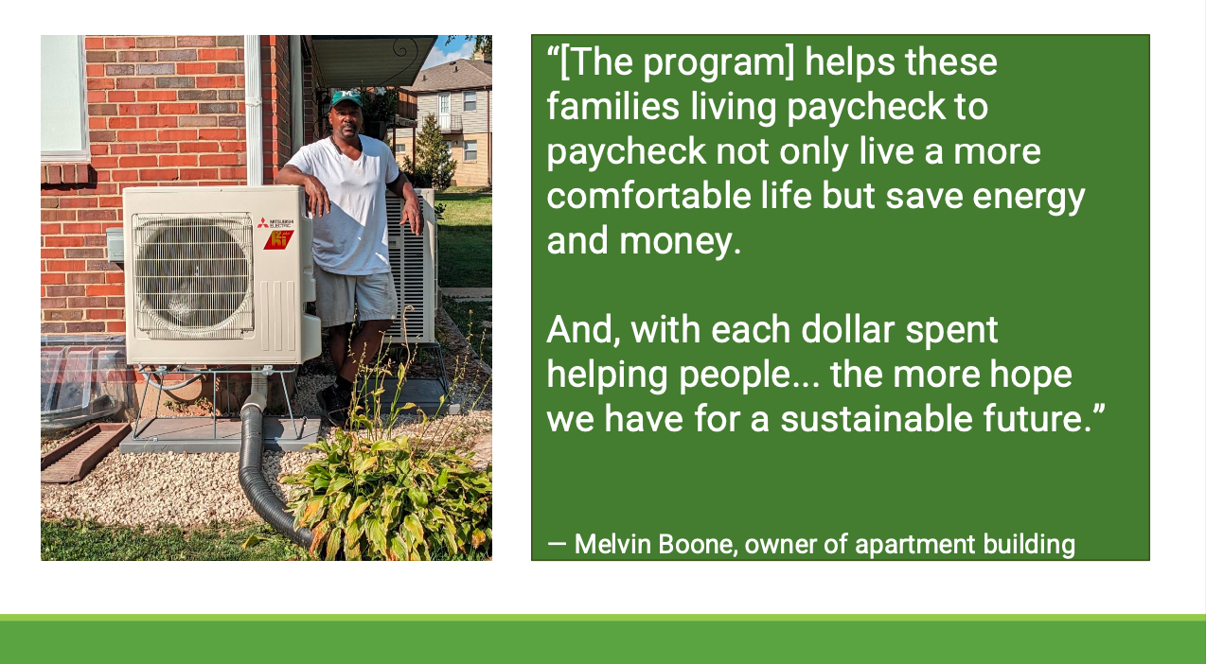

Slide 27


Slide 28
Case Study #2: NYC Accelerator
Playbook Location:
Section 3: Crafting a Well-Designed and Equitable Program
Action 6: Create an easy-to-use program intake, participation, and support process
Simon Mugo
Program Manager
NYC Accelerator

Slide 29


NYC Accelerator Program
Presented by:
Simon Mugo
Program Manager - NYC Accelerator

Slide 30
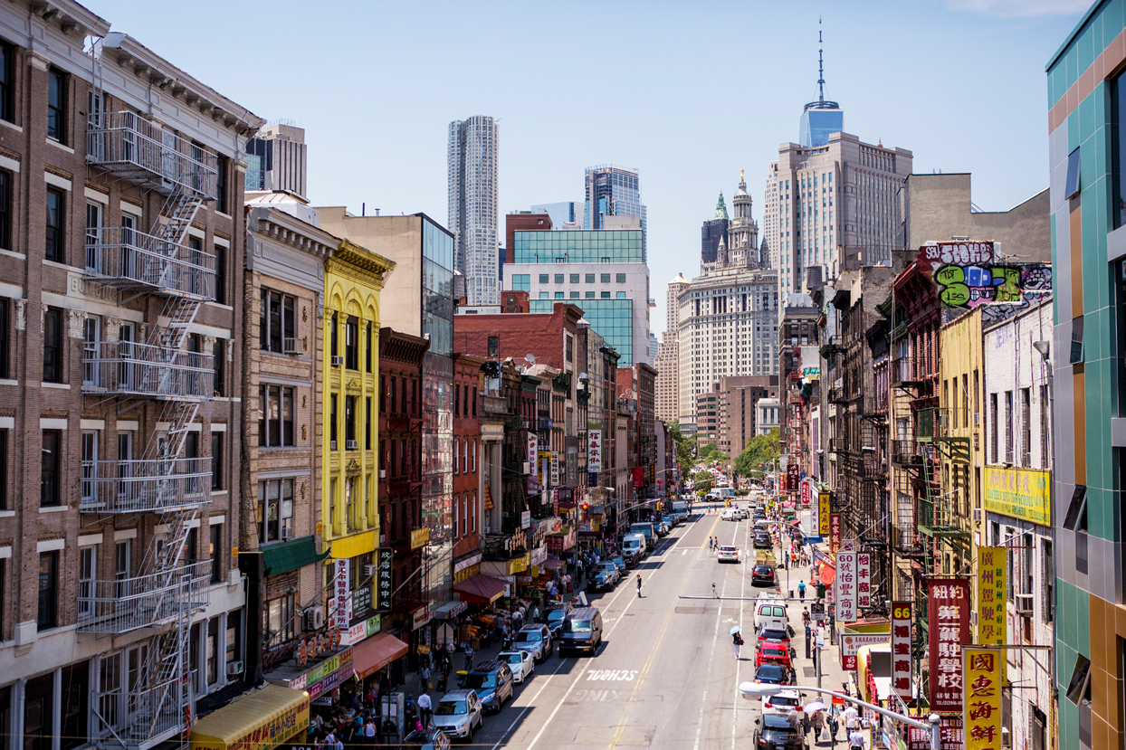
New York City’s Pathway to Decarbonization
68% of New York City’s emissions come from buildings
90% of New York City buildings will still be here in 2050
New York City aims to be carbon neutral by 2050
  Building decarbonization policies
  Free technical assistance ​
  Economic development ​
  Equitable transition away from fossil fuels

Slide 31
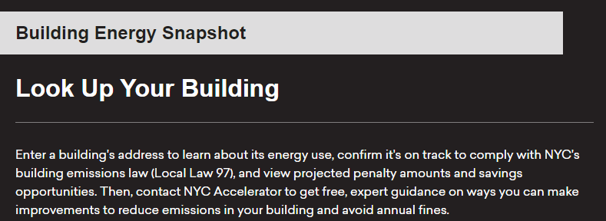
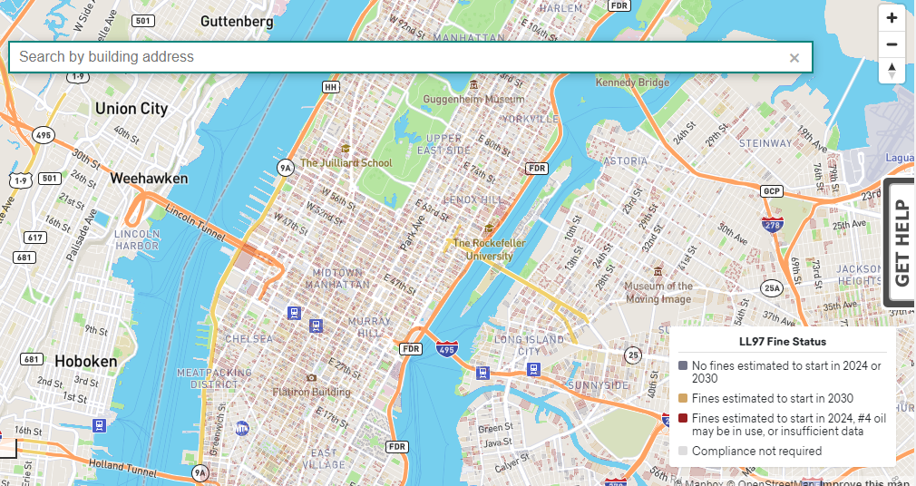
NYC Policy + ICF-led Support Programs
Heavy Heating Oil Phase Out (2012-2015)
  NYC Clean Heat Program: 2012-2015
Audits & Retro-commissioning (~2013)
  NYC Retrofit Accelerator Program: 2015-2019
Building Performance Standards (~2025)
  NYC Accelerator Program: 2019-present

Slide 32
What is NYC Accelerator?​
A New York City program to help control costs, meet compliance requirements for local laws, boost building performance, increase energy savings, and reduce carbon emissions across New York City buildings. NYC Accelerator:
  Provides free technical guidance to help transform how our buildings operate and are built
  Identifies building upgrade projects to help meet emissions limits established under the Climate Mobilization Act and other local building energy laws
  Offers no-cost trainings and supports green workforce development
  Connects building decisionmakers directly with service providers to implement decarbonization projects
  Helps buildings identify applicable financial incentives and financing, such as NYC Accelerator PACE

Slide 33
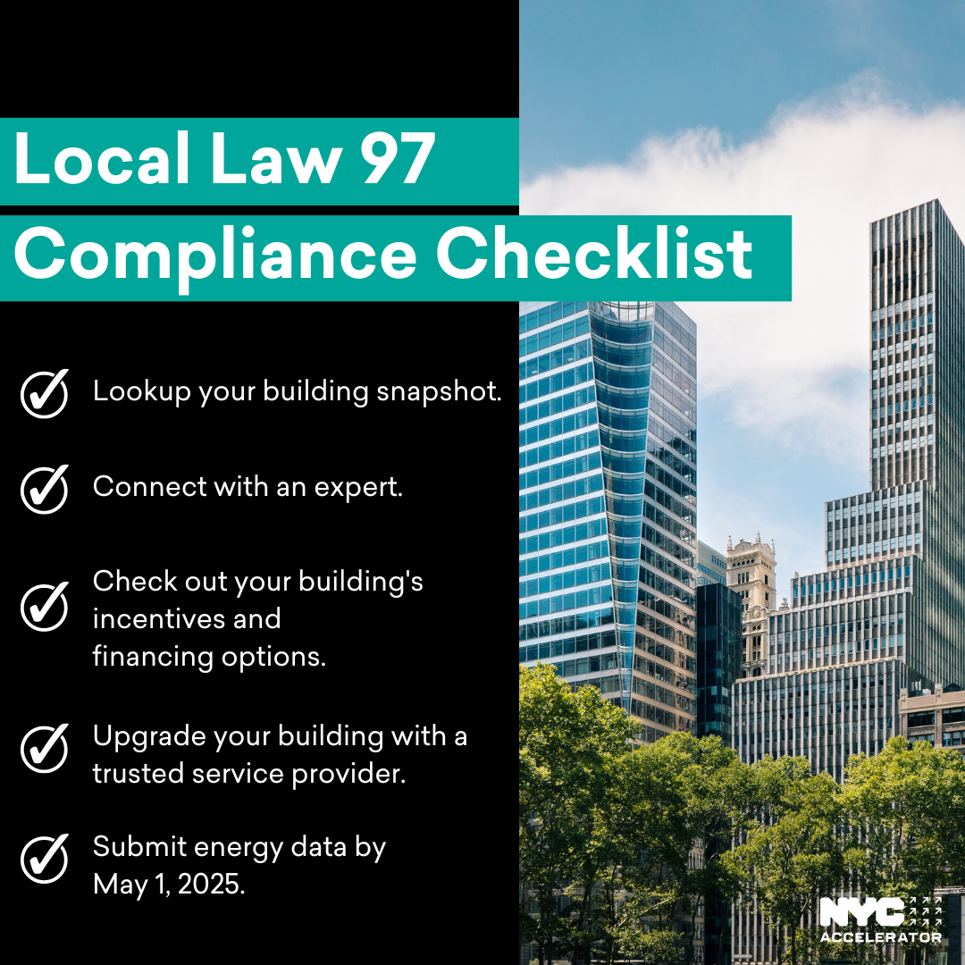
NYC Accelerator Mission and Vision
Our Mission: Mobilize all of New York City's real estate stakeholders (occupants, building owners, industry actors, etc.) toward a pathway to decarbonization, achieve the Climate Mobilization Act's requirements, and meet New York City's PlaNYC: Getting Sustainability Done goals.
Our Vision: An accelerated and just transition to carbon neutrality by 2050.

Slide 34
How Does NYC Accelerator Work?
Who is eligible?
  Any privately owned New York City building ≥5,000 square feet (new or existing)
  Smaller buildings referred to partner organizations
How does it work?
  Call us and get connected with a dedicated Account Manager
  Receive objective advice customized to your needs
How much does it cost, and what’s the catch?
  No catch, no cost, no sign-up or commitment

Slide 35
How Does NYC Accelerator Work?
Learn About Program
Building Needs Assessment
Decide
on Energy Conservation Measures
Implement Measures
Stay in Touch

Slide 36
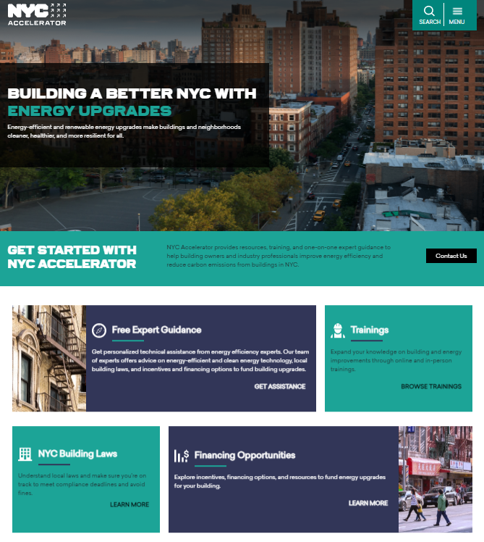
NYC Accelerator 2021 - Present
Content A
21,000+
10,000+
Buildings touched by the program (1B sq. ft. of real estate)
70% of resources dedicated to affordable housing + priority communities
Buildings started construction or completed energy efficiency, solar, and decarbonization planning
2,000+
100
Participants (service providers + owners) trained on building decarbonization
Interns placed into clean energy jobs

Slide 37
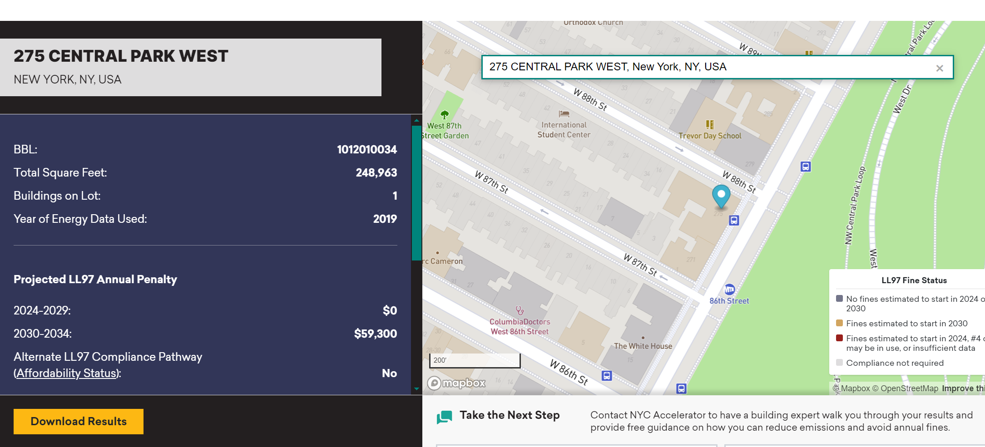
Building Look Up Tool

Slide 38
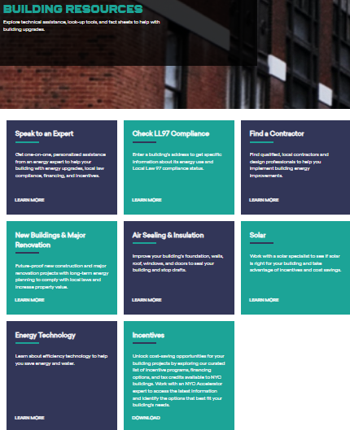
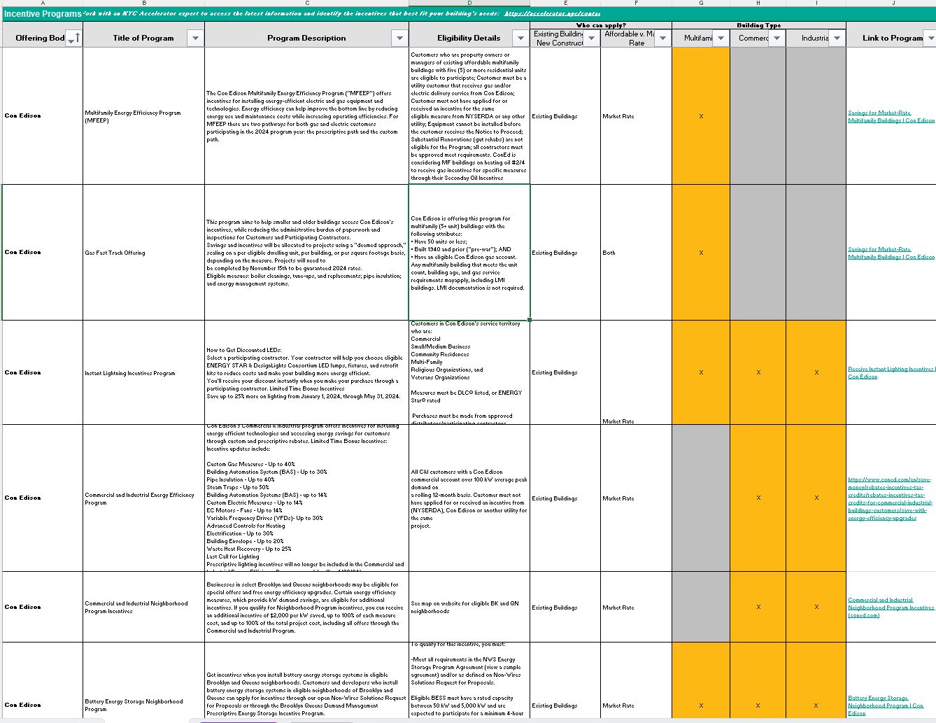
Incentive Programs
The Downloadable Incentive List includes:
40 Incentive Programs
Financing and IRA (Evolving) Programs

Slide 39
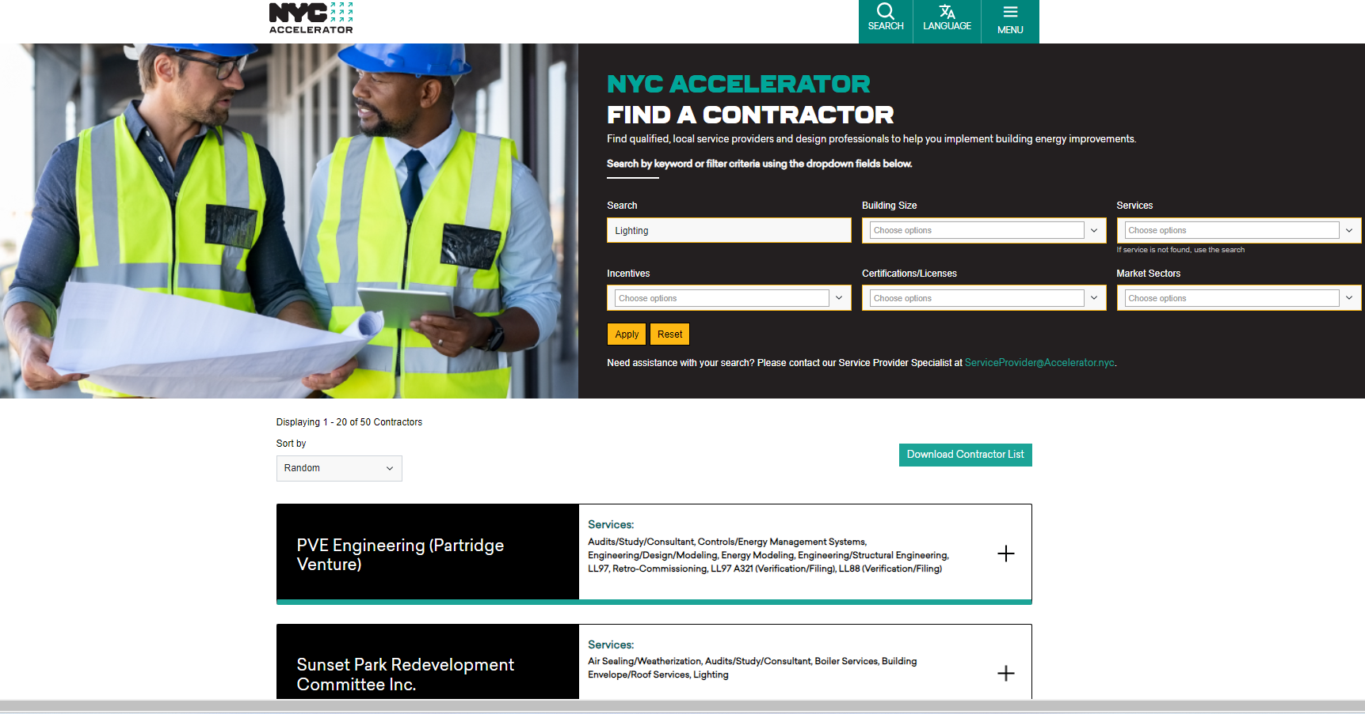
Service Provider Look Up Tool

Slide 40
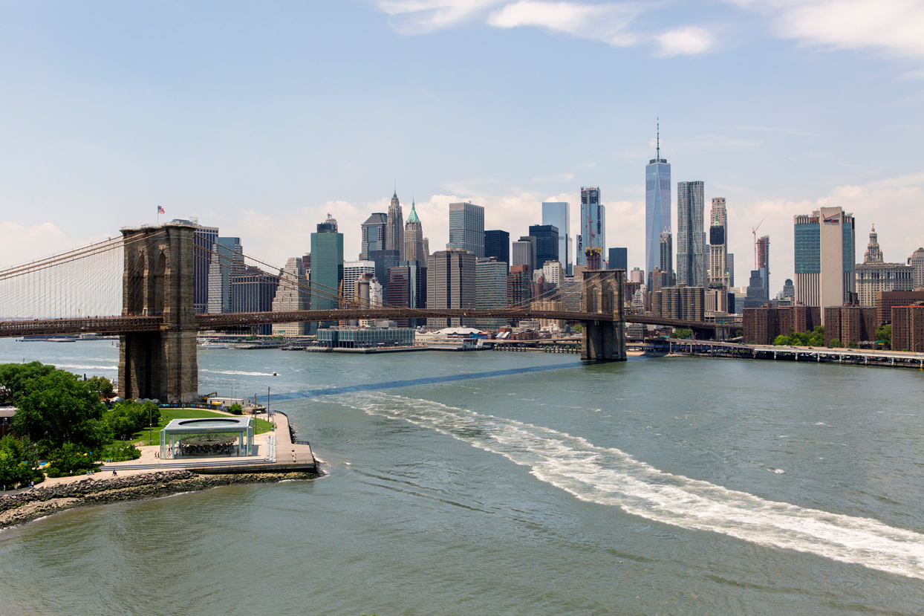
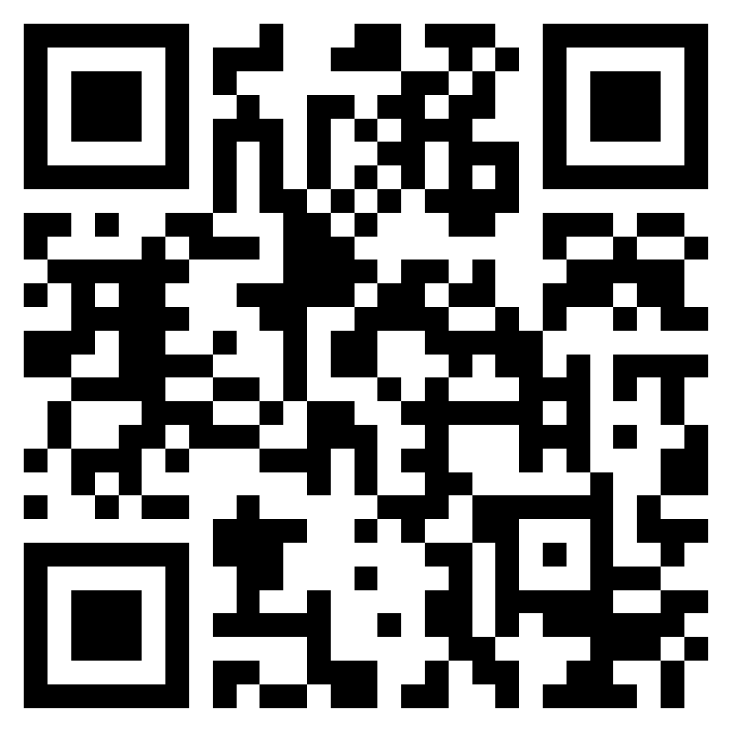
Contact
Our Team
of Experts
Web: accelerator.nyc
Email: info@accelerator.nyc
Phone: 212-656-9202

Slide 41
Case Study #3: New Ecology
Playbook Location:
Section 3: Crafting a Well-Designed and Equitable Program
Action 7: Design program in coordination with partners
Marty Josten
Principal Director
Building Decarbonization, New Ecology

Slide 42

Collaboration is Key
New Ecology works nationally to bring the benefits of sustainable development to the community level, with a concerted emphasis on underserved populations.
A mission-driven non profit, we seek to make the built environment more efficient, healthy, durable, and resilient.
CORE WORK in Buildings:
Examine & Diagnose
Strategize & Solve
Certify & Verify
Train & Share
Research & Test
Notes:
Quick introduction to New Ecology – we bring the technical capacity to projects …
I was asked to speak to you about how some of our projects – case studies linked in the Playbook -carefully coordinated the work of multiple programs –
- want to start with how the infrastructure for coordination that enabled these projects came about --- it is needed elsewhere, and part of what NEI is doing is trying to replicate it – to a degree – in other places we work; focus of IRA resources …

Slide 43
Collaboration – building the infrastructure
MA – many resources, progressive code & other regulatory drivers – now …
  The Costs and Benefits of Green Affordable Housing
    Collaborated with Tellus Institute to address the high cost argument
  Making the case for oversight of Multifamily properties
    Collaborated with ABCD* to design affordable housing programs, carve outs
  Understanding Affordable Multifamily Housing performance
    Collaborated with LISC**, Mass Housing to conduct statewide benchmarking project
  Finding resources to help Affordable Multifamily Developers access programs
    Collaborated with LISC to secure HUD funds for the MA Green Retrofit Initiative
  Finding resources to formalize an on-going collaboration
    Collaborating with LISC and MACDC*** to create/maintain the AMF housing community for education, problem-solving, advocacy – spin off groups
*ABCD = Action for Boston Community Development; Cap agency that administers Low-income programs
** LISC =Local Initiatives Support Corporation
***MACDC = Massachusett's Association of Commuinity Development Corporations
Notes:
- not always the case
2005 – study of what it takes to green - and, oh BTW, the multifamily sector has been overlooked in the state’s utility program
Clean CDCs initiatives –
MAGRI no longer exists, but the experience lent itself to DASH – Decarbonizing Existing Subsidized Housing
I have only touched on a couple collaborators – there are others – one, in particular, that I should mention is the MA Clean Energy Center – quasi-state entity that is shaping the direction of the next phases of work and providing funding; the MA DOER is

Slide 44
Collaboration – approaching the project work
Atwood Acres
2013
50 units, built in 1988
Failing mechanical equipment
Efficiency, not decarbonization
No refinance, no real plan ….not a-typical at this time in MA
Nonantum Village
2021
35 units; built in 2004
Aging equipment, capital upgrades project. strategy
Efficiency AND decarbonization with partial electrification
First ZOT plan– capital upgrades plus 10-year plan for balance of work and ideas on how funded
Treehouse
2022
60 units in 23 buildings
Deep energy retrofit at time of refinance
Energy and carbon redx, embodied carbon
Multiple design scenarios and trade offs debated with owner and design team
Notes:
Atwood –Towsend, MA, 60 miles northwest of Boston. this project is over a decade old; 50 units built in 1988 – failing equipment around 2013; served by MAGRI – collaboration between LISC Boston, now MA, and NEI to bring properties through the newly minted LEAN program – educational - installed these crazy things called high efficiency boilers - maximized benefits from the effort, solving more than the original ask
The Massachusetts Green Retrofit Initiative (MAGRI) is a project of New Ecology, Inc. (NEI) and LISC Boston. Through MAGRI, NEI and LISC Boston serve as a one-stop-shop to provide holistic energy management services to property owners. This project has been funded by the Barr Foundation and a U.S. Department of Housing and Urban Development Energy Innovation Fund grant.
Nonantum Village - Newton, MA, 15 miles due west of Boston, wealthy, progressive community – active climate committee, pushing aggressive code adoption, putting money towards improving what they see as a valuable asset – affordable multifamily; progressive developers – local CDC that wants to push envelope sensibly, really looks out for their senior residents ….
Treehouse – Easthampton, MA,100 mile west of Boston; decently rural, progressive for-profit developers based in Boston; full design team because refinance –

Slide 45
Coordinating – piecing it together
Atwood Aces
Federally funded – via a competitive HUD grant we used to develop a program – Owner education and Scope Development (Owner’s Rep function)
Ratepayer funded – via the LEAN program – retrofit implementation
Nonantum Village
Client funded Scope Development, ZOT plan
Capital Project – City of Newton, LEAN, MA DEP, foundations
(short term) Over Time upgrades – actions at turnover, operating reserves, replacement reserves
(longer term) Over Time upgrades – new LEAN pathways (DER, electrification), replacement reserves
Treehouse
Client funded Design Team
LEAN DER program
LISC/MHP* Climate Ready Housing Program
MA DOER Low to Moderate Income Housing Decarbonizatinon Grant Program
Tax Re-syndication
*Massachusetts Housing Partnership

Slide 46
Question & Answer Session

Slide 47
Mark your calendar
August 20, 2024
ENERGY STAR and R2E2 present:
Well-Designed Equitable Home Energy Upgrades:
Best Practices and Strategies
Using R2E2’s Playbook, this workshop will do a deeper dive into specific best practices for program design.
For more information: https://www.energystar.gov/equitableupgrades

Slide 48




Thank you from the R2E2 Partners

Slide 49





Thank you to our funders

